Slide 1
Guitar Hero with Gesture Detection

Slide 2
Table of contents
01
02
03
04
Introduction
Circuit
Acquisition
Gesture Detection
05
06
Demonstration
Conclusion

Slide 3
01
Introduction

Slide 4
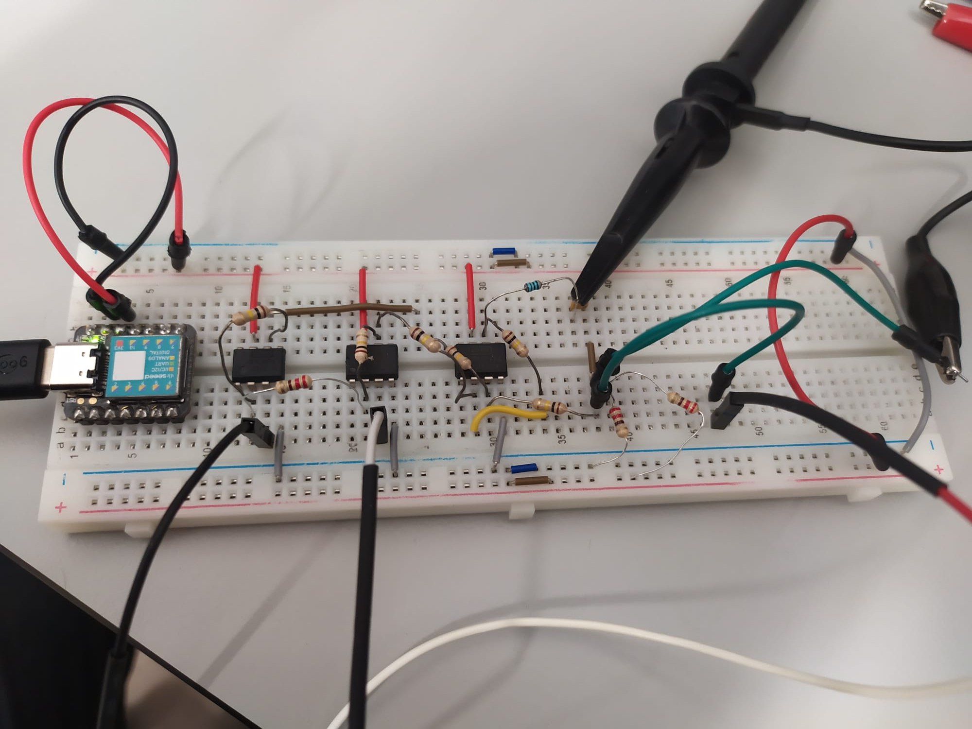
The project
The project involves creating a system that enables users to control a Guitar Hero game using their muscle signals.
The system works by detecting and amplifying the electrical signals that muscles produce when they contract or relax.
The system has diverse applications in the area of human-computer interaction, particularly for individuals with physical disabilities or impairments that hinder their use of conventional input devices

Slide 5
02
Circuit

Slide 6
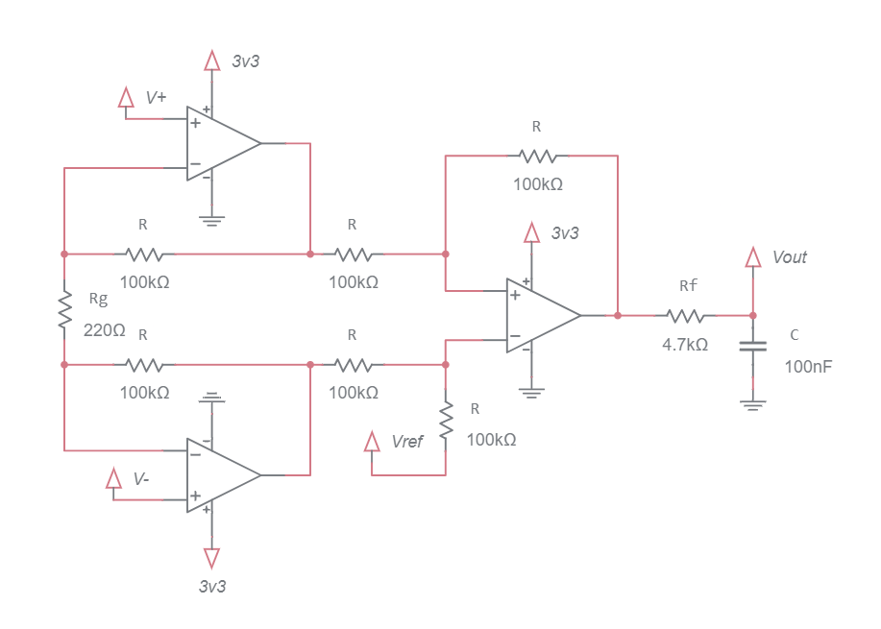
Design of the circuit
The sensor circuit that was built consists of two main parts: an instrumentation amplifier and a low-pass filter.
As the microcontroller does not read negative voltages, the solution found was to create an offset of 1.6V.
The filter used to eliminate high-frequency noise was an RC low-pass filter with a cutoff frequency of approximately 330Hz. For this, a Rf = 4.7kΩ resistor and a C = 100nF capacitor were used.

Slide 7
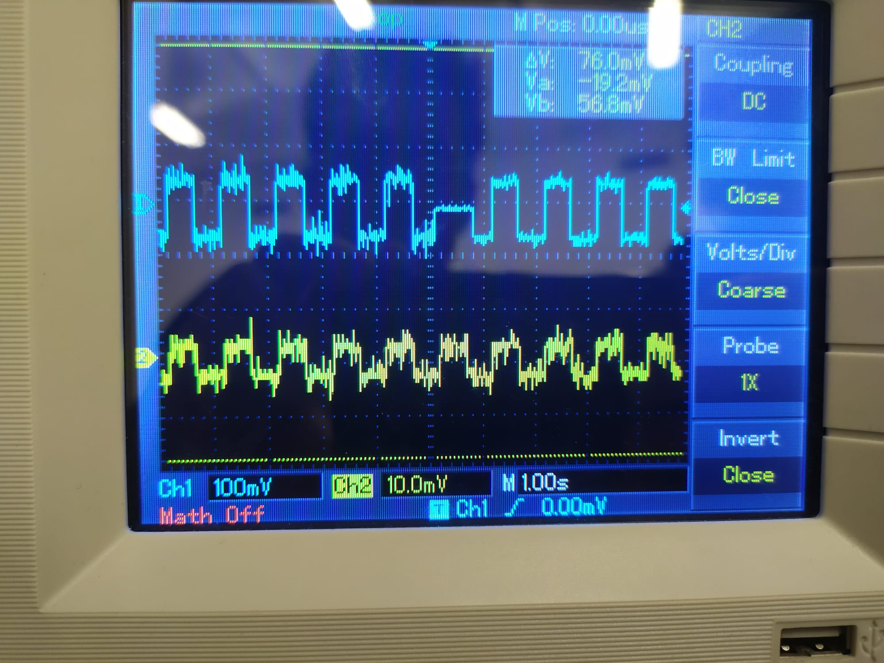
Testing with square waves
During the making of the circuit, tests were carried out in order to understand the operation of each functional part.

Slide 8
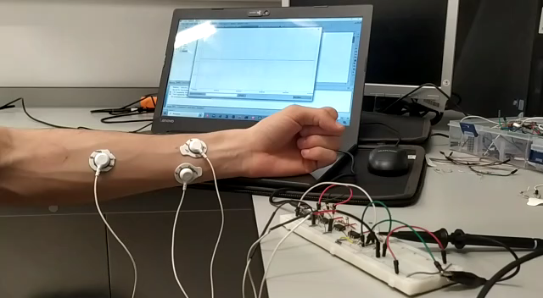
Testing with muscle signals
A test was performed whose inputs were the muscle contraction signals.
It is possible to see that the results were very positive, the amplification and filter circuit works with muscle contraction.

Slide 9
03
Acquisition

Slide 10
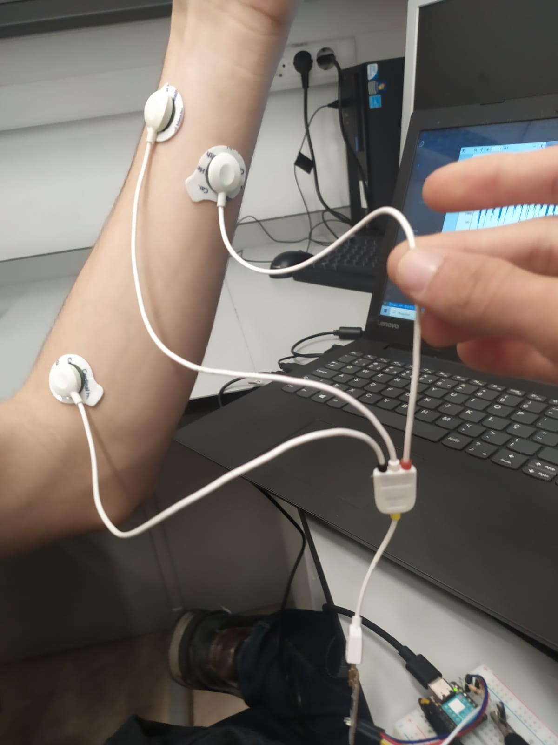
Electrodes placement
During the lab sessions, we collected the necessary data to run the predictive model of the gestures.
The positions chosen for the detection of gestures can be seen in the figure on the right side.
Finally, we select 4 gestures that are distinctly between each other to control the game.

Slide 11
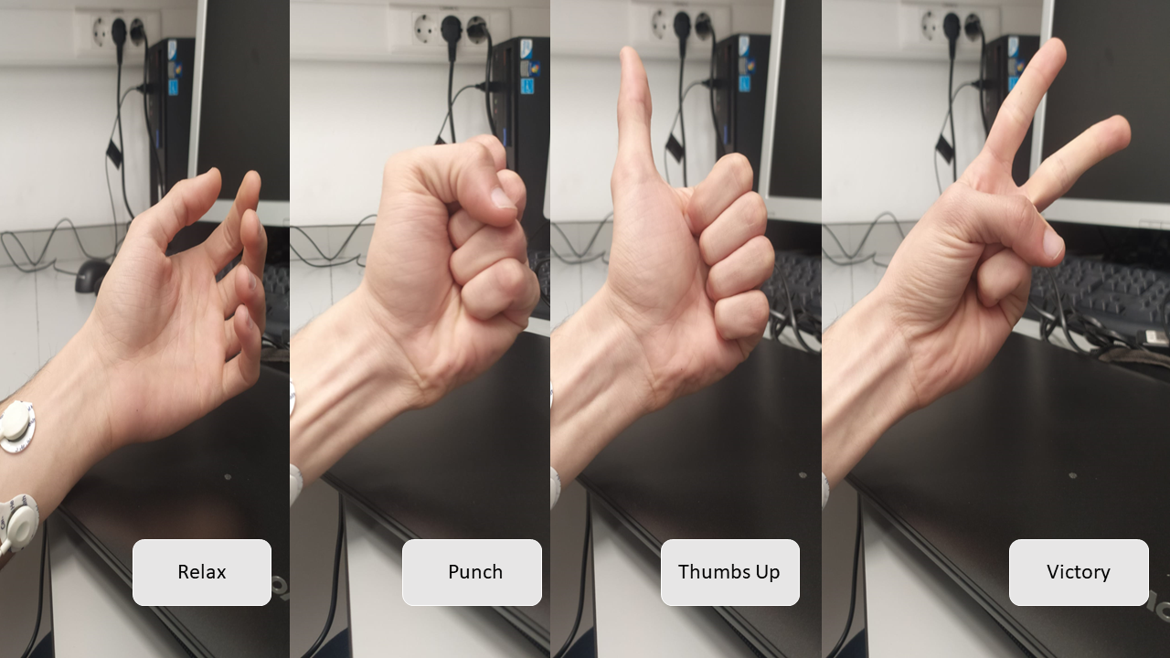

Slide 12
04
Gesture Detection

Slide 13
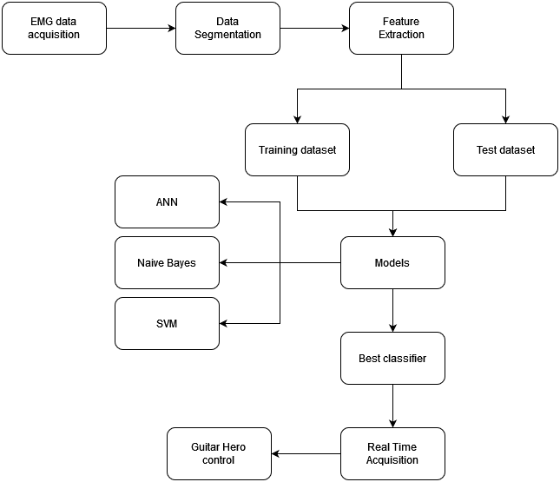
Software workflow
We segmented the data we collected to extract relevant information about how each gesture is characterized using brush data
We then separated it into segments of 200 ms.
We used time domain features to train the model.
Selection of the best model that was trained (ANN, Naïve Bayes).
Usage of the best classifier in real time acquisition.
Control of the game based on the prediction of the model

Slide 14
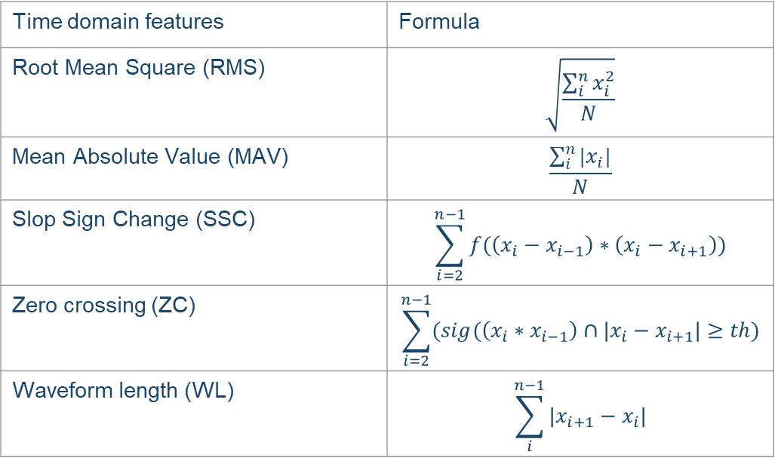
Feature extraction
TD features are easy to extract as they do not require additional transformations on the data.
Time domain features | Formula
Root Mean Square (RMS) | $$\sqrt{\frac{\sum_{i}^{n}{x_{i}^{2}}}{N}}$$
Mean Absolute Value (MAV) | $$\frac{\sum_{i}^{n}{|x_{i}|}}{N}$$
Slop Sign Change (SSC) | $$\sum_{i=2}^{n−1}{f(\left(x_{i}−x_{i−1}\right)∗\left(x_{i}−x_{i+1}\right))}$$
Zero crossing (ZC) | $$\sum_{i=2}^{n−1}{(sig(\left(x_{i}∗x_{i−1}\right)∩|x_{i}−x_{i+1}|≥th)}$$
Waveform length (WL) | $$\sum_{i}^{n−1}{|x_{i+1}−x_{i}|}$$

Slide 15
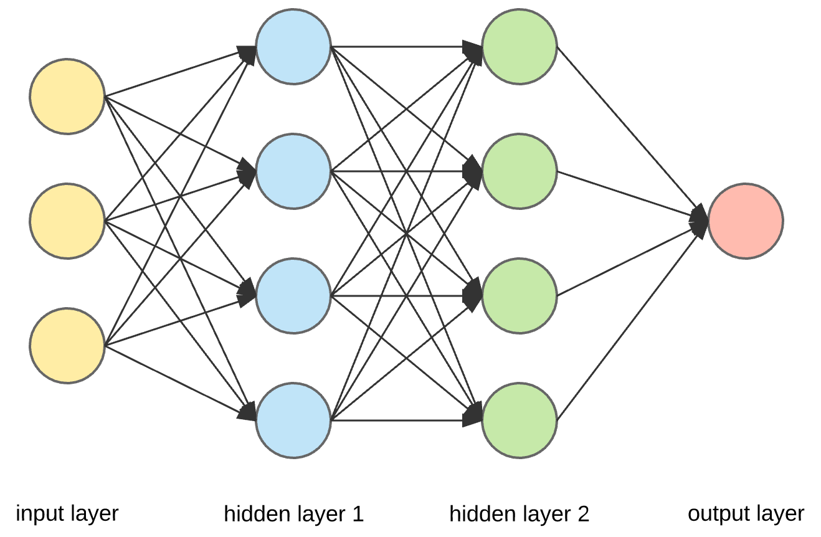
Machine learning algorithms
Naïve Bayes - applying Bayes’ theorem with the assumption of conditional independence between every pair of features.
SVM - finds a hyperplane in an N-dimensional space that distinctly classifies the data points.
Artificial Neural Network (ANN) - mimickers the way that biological neurons signal to one another.
Model | Accuracy
SVM | 89%
ANN | 70%
Naive Bayes | 55%

Slide 16
05
Demonstration

Slide 17
Conclusion
In this work, the viability of using EMG sensors as controls for games, among other types of applications, was shown.
The prediction system still has a lot of room for improvement:
Exploring other classification techniques.
Increasing the number of features extracted from the signal
Increasing the training dataset.
Increasing the number of channels

Slide 18
Thanks for your attention
Any questions?

